Slide 1
Online Car Rental System
Ragchaabazar Bud – 987063
Khaliun Samdanjamts – 962084
Williert Charles – 986763
Wilfrid Jules - 986709

Slide 2
Online Car Rental System’s
Topic
Vision Document
Use Case Diagram
Use Case Description
Architectural Analysis
Sequence Diagrams
Collaboration Diagram
VOPC Classes

Slide 3
Introduction
Five years ago, the company has launched car rental service which had 2 locations and 50 cars in total. The company has been developing, the income and capacity of service as well as locations and cars have been increasing. Now the company has 15 branches in Illinois and Iowa states and 300 cars in total. We offer 6 general types of rental cars which are Small cars, Normal cars, Vans, Premium cars, SUVs and Large cars. However, the company has many cars, they manage their service manually it tends to costly management. That’s why the company needs online car rental system that manage the operation of the company that is user friendly and cheaper then previous management.

Slide 4
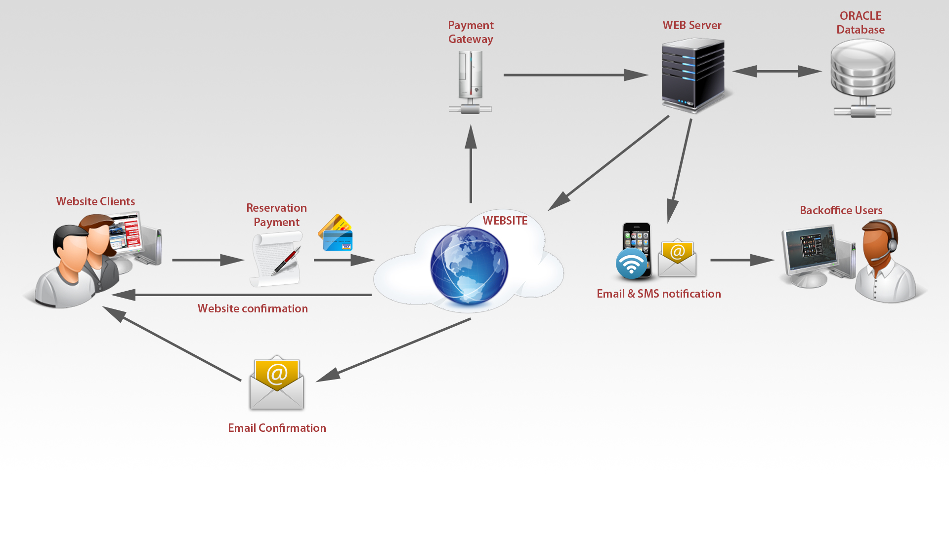
Online Car Rental picture

Slide 5
I. Vision Document
1.1. Problem Statement
The problem of | having traditional way car rental service which is not connected all information each another
Affects | The company’s development and competition
the impact of which is | managing the rental car company manually is costly and it tends to the company miss the market status
a successful solution would be | To create a car rental service system that integrates the business rules for consumer needs and supply rental car based on customer needs. This system will provide a database and a user interface that is easy to use for customer and staff.

Slide 6

1.2 Product Position Statement
For | Car rental company
That | Needs to manage renting cars
The (product name) | Online car rental system
That | Offers rental vehicles for customers
Unlike | Traditional which is not connected information
Our product | keeps tracks of vehicles, staff, customers and booking. It provides useful information to the staff such as giving daily reports of vehicles to be delivered/picked up and acts as a vehicle management system by monitoring the use and price of the vehicles.
2. Stakeholder Description
Name | Description | Responsibilities
Admin | Admin add, edit and delete things on the system | Admin is responsible for setting up, insert vehicle metadata and managing system
Staffs | Staffs show and manage the vehicles that they rent from their branch | Staffs are responsible for showing the vehicle information and manage the rental process on the system.
Customers | Customers can see vehicle detail information including price and rent the car whatever available. | Customers are responsible for signing up on the system and paying for the rental cars as well as pick-up and deliver the vehicle that they rented from the company.

Slide 7
1.4. Needs and Features
No | Problem | Need | Priority | Priority |  |  | Features
Admin
1 | The company offers six general type cars | Cars must be divided by six types |  |  | Admin must separate vehicle information by six different type |  | Admin must separate vehicle information by six different type
2 | Each car has a car type, year, mileage | Cars can be categorized by car type, year, mileage and etc. |  |  | Admin must be able to add or delete vehicle information by car type, year, mileage etc., |  | Admin must be able to add or delete vehicle information by car type, year, mileage etc.,
3 | Each location(branch) has their own vehicle information | Cars located in 15 different places, they can be changed one another. |  |  | Admin must add, change and delete vehicles location information on the system |  | Admin must add, change and delete vehicles location information on the system
Staff
5 | Staffs can login the system with their own privileges | Staff be able to view the vehicle information |  |  |  | Staffs can login the system with their username and password which are given by Admin | Staffs can login the system with their username and password which are given by Admin
6 | Staffs can reserve a car or cancel a reservation when customer requests him/her to do it | Staffs can be able to reserve or cancel reservation |  |  |  | Staffs can reserve a car or cancel reservation on the system when customer ask them by phone, walk-in or by customer support service | Staffs can reserve a car or cancel reservation on the system when customer ask them by phone, walk-in or by customer support service
Customer
7 | Customers can sign-up the system when they decided to rent a car or existing customers can sign-in the system with their own privileges | Customers can be able to sign-up or sign-in to the system |  |  |  | Customers can sign-up the system and create their personal info including payment information when they decided to rent a car (existing customers can sign-in the with their username and password which they created themselves) | Customers can sign-up the system and create their personal info including payment information when they decided to rent a car (existing customers can sign-in the with their username and password which they created themselves)
8 | Customers can make or reservation for rental car on the system | Customers can be able to reserve a car or cancel the reservation. |  |  |  | Customers can reserve a car or cancel the reservation car, once customer signed-in the system. | Customers can reserve a car or cancel the reservation car, once customer signed-in the system.
9 | Customers can make a payment for rental car | Customers can be able to make a payment |  |  |  | After choosing the rental car, customer must sign-in the system and make a payment for rental car one of the three different ways | After choosing the rental car, customer must sign-in the system and make a payment for rental car one of the three different ways

Slide 8
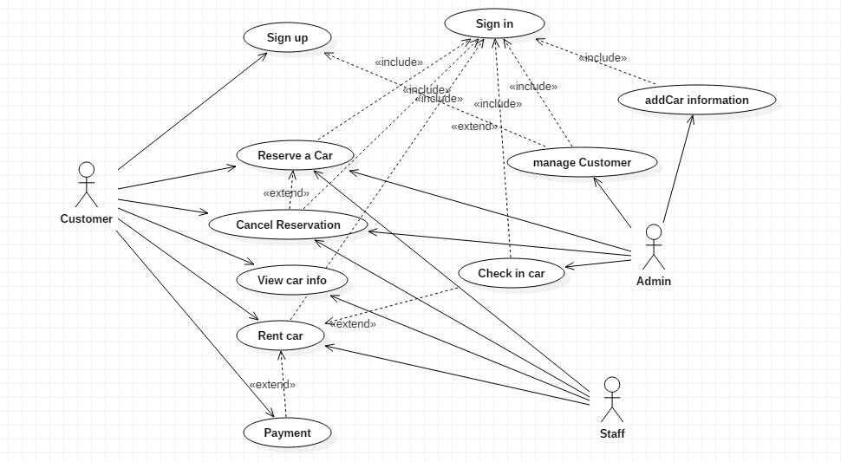
II.Use-Case Diagram

Slide 9
III. Use-Case Description
3.1. Name: Sign-up
3.1.1. Brief Description
This use case allows the Customer to signup to the CAR RENTAL System.
3.1.2. Actors: Customer
3.1.3. Pre-Conditions: The user must have a driver license.
3.1.4. Flow of events
3.1.5. Post-Conditions
If the use case is successful, all information of the Customer save into the system. If not, the system displays a message to contact office and provides by phone.
3.1.6. Business Rules:
Every customer and admin must be authenticated into the system.
3.1.7. Nonfunctional requirement: None
User Actions | System Actions
The user enter first name, last name, sex, address, driver license and password into the screen and clicks submit. | The system validates the all fields and the return a confirmation message with an ID.

Slide 10
3.1. Name: Sign-in
3.2.1. Brief Description
This use case allows the administrator or the Customer to signup to the system
3.2.2. Actors: Customer, Admin
3.2.3. Pre-Conditions: The users have an Account in the system and then Admin or Customer privileges.
3.2.4. Flow of events
3.2.5. Post-Conditions
If the use case is successful, the Customer or Admin is logged into the system. If not, the system displays a message to contact office and provides by phone.
3.2.6. Business Rules:
Every customer and admin must be authenticated into the system.
3.2.7. Nonfunctional requirement: None
User Actions | System Actions
The user inputs username and password into the login screen and clicks submit. | The system validates the entered username and password and logs the user into the system with User interface components according to the user type (Customer page or Admin page)

Slide 11
3.3. Name: Add car
3.3.1. Brief Description
This use case allows the administrator do add a new car
3.3.2. Actors: Admin
3.3.3. Pre-Conditions: The user must have logged in to the system
3.3.4. Flow of events
3.3.5. Post-Conditions
If the response is ok, redirect to see the list of cars. If the response is failed, needs to show the message.
3.3.6. Business Rules:
Admin must be authenticated into the system.
3.3.7. Nonfunctional requirement: None
User Actions | System Actions
The Administrator fill the fields of the from add new car | The System save the new car and retrieve the status

Slide 12
3.4. Name: ReserveCar
3.4.1. Brief Description
This use case allows the customer request for a booking a car
3.4.2. Actors: Customer/Staff
3.4.3. Pre-Conditions:
The customer and staff must logged in to the system
3.4.4. Flow of events
3.4.5. Post-Conditions: The status of the car will be changed, and the booking detail will be persisted on database
3.4.6. Business Rules:
Total cost of booking must not exceed the customer's current balance
3.4.7. Nonfunctional requirement: None
User Actions | System Actions
The customer selects a car and press "View Detail" button | The system displays detail of the selected car
The customer view car detail, fill rent duration and press button | The system checks if the input is valid and displays confirmation page. The system displays appropriate error message and redirect the user on the same page Go to step 2

Slide 13
3.5. Name: Make Payment
3.5.1. Brief Description
This use case allows the customer do payment using of new platform.
3.5.2. Actors: Customer
3.5.3. Pre-Conditions:
The customer must logged in to the system and before select a car to do payment.
The customer has enough money on her account to do payment.
The Flow of do Booking sent a request with details about this transaction
3.5.4. Flow of events
User Actions | System Actions
The customer selects a car to rent. | The system display of balance over user account. The platform shows a summary about request. If the vehicle is not availed, show error and not allow continue the process.
The customer does click over make payment | The platform debit from account of customer, in function of how many days that will be renting the. The platform changes the status of car to rent. If the vehicle is not availed, show error and not allow continue the revert any transaction money from customer account.

Slide 14
3.5.5. Post-Conditions
The balance account of customer reduces on function of payment.
The car rented change the status to rent.
The platform cannot not show cars with status rent.
3.5.6. Business Rules:
The most important thing Is that, only is possible discount the value of rent a car, not more or less.
The platform notifies to customer about the state of transaction.
3.5.7. Nonfunctional requirement: None

Slide 15
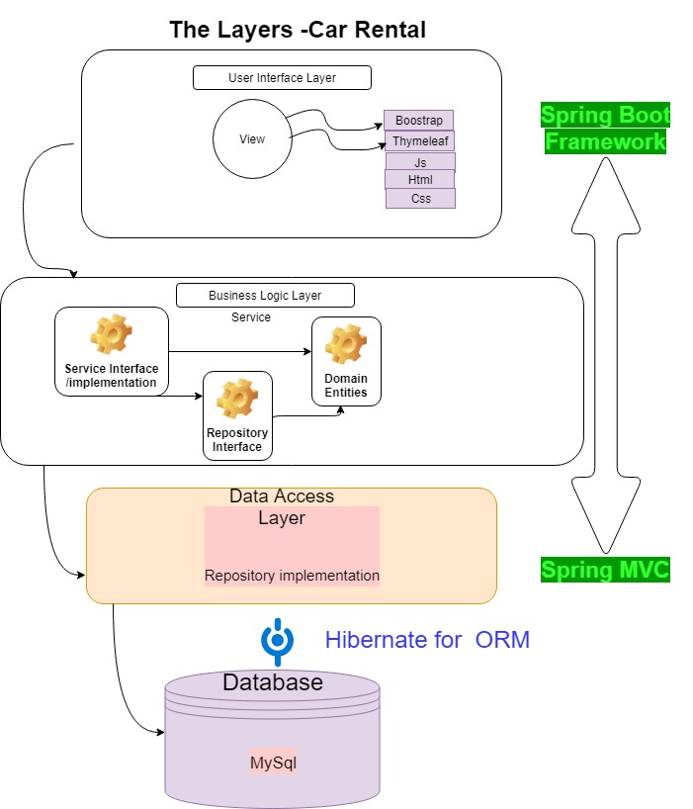
IV. Architectural Analysis

Slide 16
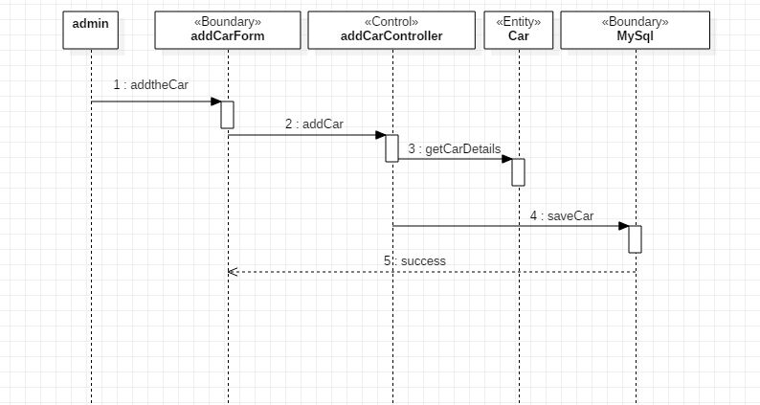
V. Sequence Diagram
5.1. addCar sequence Diagram

Slide 17
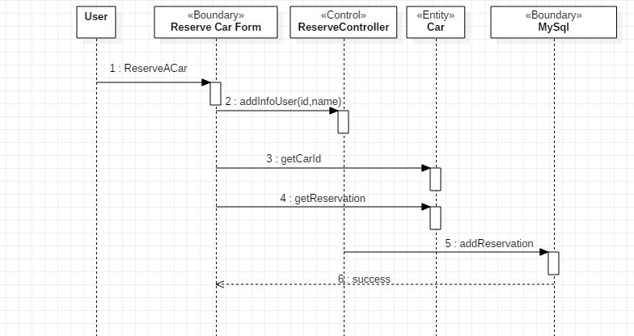
5.2. reserveCar Sequence Diagram

Slide 18
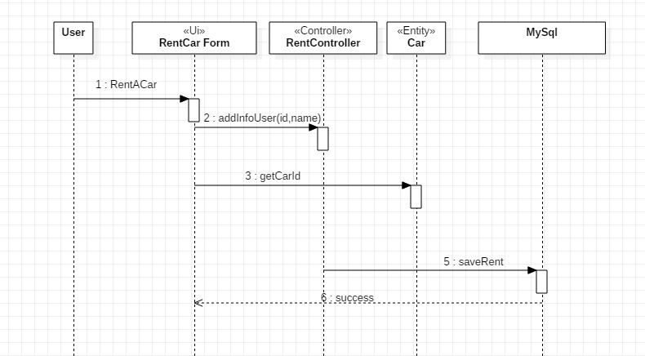
5.3. rentCar Sequence Diagram

Slide 19
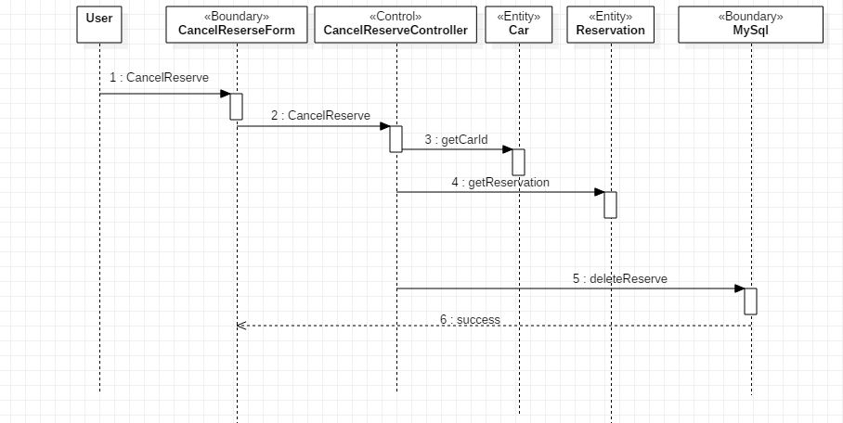
5.4. cancelReservation Sequence Diagram

Slide 20
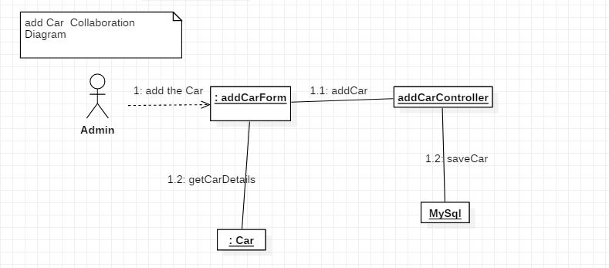
Collaboration Diagram - addCar

Slide 21
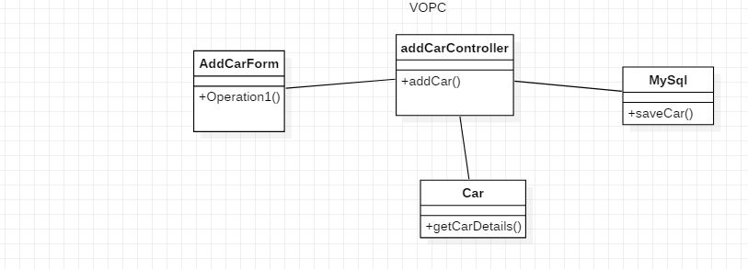
VOPC

Slide 22
Thank you for your attention ☺

